Slide 1
COVID-19 vaccinations learning resource
Key Stages 3–5
February 2021
Refer to teacher notes at the bottom of each slide
Notes:
Welcome to the COVID-19 vaccinations learning resource for Key Stages 3–5.
How to use it:
Download the powerpoint presentation onto your desktop first. Click through the pages, some slides are animated and clicking through will take you to the next page.
The teacher notes at the bottom of most slides may provide some guidance as to how to deliver the lesson, questions you may want to ask and useful information (or links to information).
You will see key questions in the powerpoint which can be asked having watched short videos, gone through written information, and analysed diagrams and data. For the final activity pupils will consider how they might respond to people who are hesitant about receiving the COVID-19 vaccine. This could be a writing task.

Slide 2
A.
B.
Smoke alarms
Anti-smoking campaigns
C.
D.
Which of these measures saves the most lives every year?
Vaccinations
Compulsory seat belt wearing
Notes:
Look at the pictures and ask the students which one they think will save the most lives every year?
You may want to get the pupils to vote and take a poll.

Slide 3
Answer: Vaccinations
All four of these measures save lives. However, vaccinations save more lives than the other three put together.
The World Health Organization estimates that vaccinations save 2 million lives a year.
Notes:
Teachers may want to mention that vaccinations also prevent even more people from getting ill every year.

Slide 4
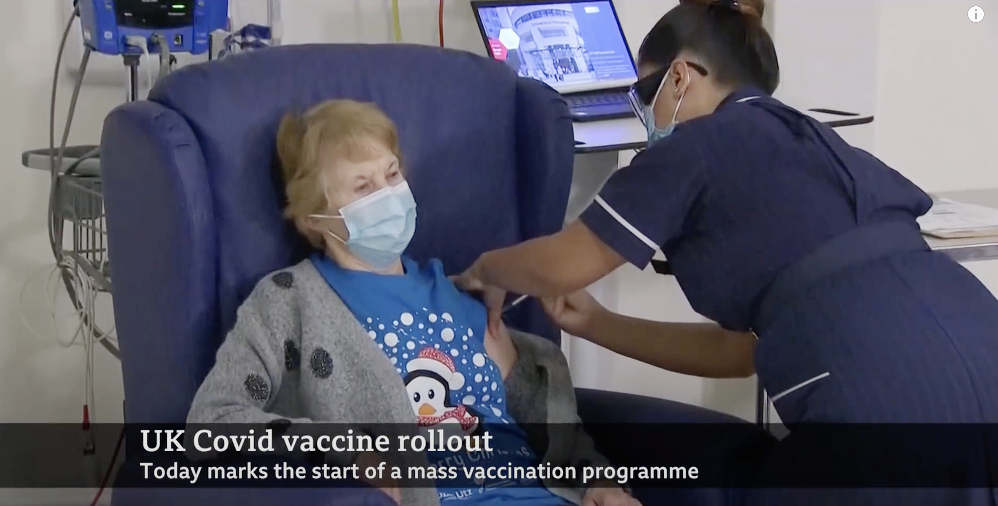
Margaret Keenan was the first person in the world to receive a COVID-19 vaccine on 8th December 2020.
If your GP offered you the vaccine for COVID-19 today, would you take it?
© BBC News
Do you know someone who has received the COVID-19 vaccine?
Notes:
This slide may be used to ascertain pupils’ views on the vaccine. Avoid a lengthy discussion at this point.
Margaret Keenan video, BBC News:
www.youtube.com

Slide 5
What is a vaccine?

Slide 6
A vaccine is a medicine which protects people from getting a disease. Vaccines are made from dead or inactive versions of viruses or bacteria.
What is a vaccine?
Vaccines stimulate the body’s immune system to produce chemicals called antibodies which can prevent illness. Vaccines themselves cannot give you the disease.
A vaccinated person should be able to produce the correct antibodies very quickly and therefore fight the disease.
Notes:
Glossary KS 3–5:
Antibody: Proteins that are produced by a type of white blood cell in your body that can help identify and neutralise bacteria and viruses that cause disease.
Bacteria: A type of micro-organism that can cause disease.
Immune system: The complex system of organs, cells and chemicals in your body that helps fight infection.
Virus: Another type of micro-organism that can cause disease.
Glossary Upper KS 2:
Antibodies: A protein produced by white blood cells which binds to the microbe it recognises making the microbes easier to destroy by the white blood cells.
Bacteria: Microscopic single celled microbe that can be beneficial or harmful to humans.
Disease: An illness that has a group of signs or symptoms.
Fungi: The largest of the microbes that can be found in the air, on plants and in water.
Highest risk: more likely than others to get a particular disease, condition or injury.
Illness: Poor health resulting from disease.
Immune system: The collection of organs, tissues, cells, and cell products such as antibodies that helps to remove microbes or substances from the body.
Microorganism: Living organisms that are too small to be seen with the naked eye.
Most vulnerable: a person in need of special care, support, or protection because of age, disability, or being at risk of other illness.
Processes: a series of actions or steps taken in order to achieve a particular end.
Protection: a person or thing that protects someone or something.
Regulations: a rule made and maintained.
Viruses: The smallest of the microbes, viruses cannot survive on their own and need to live in the nucleus of other living organisms.

Slide 7
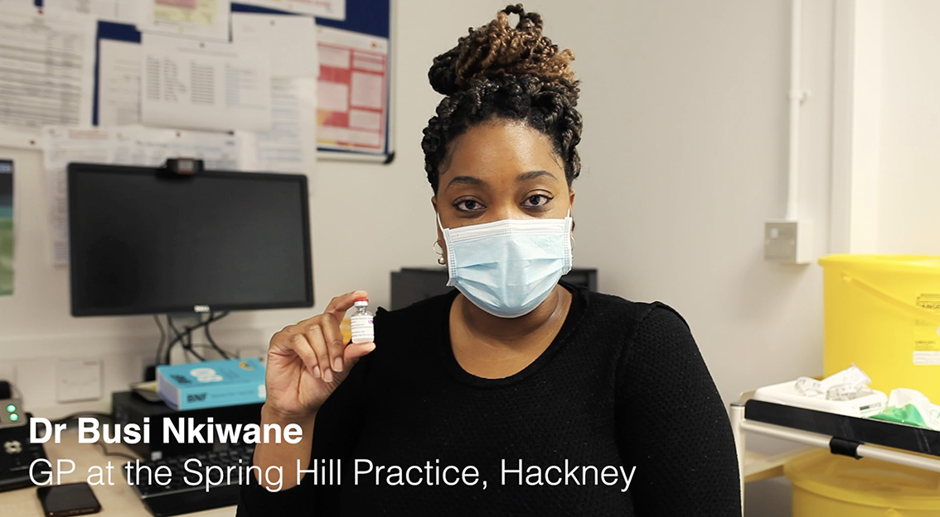
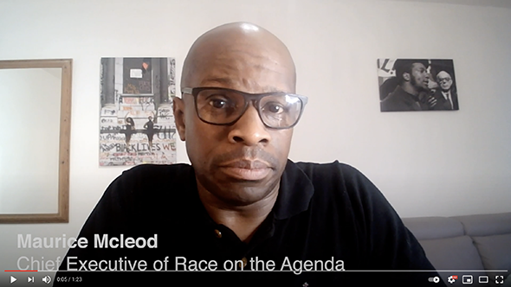
Dr Busi Nkiwane, GP at Spring Hill Practice, Hackney
Maurice Mcleod, Chief Executive of Race on the Agenda
Thoughts on the COVID-19 vaccine
What are the key messages from these two videos?

Slide 8
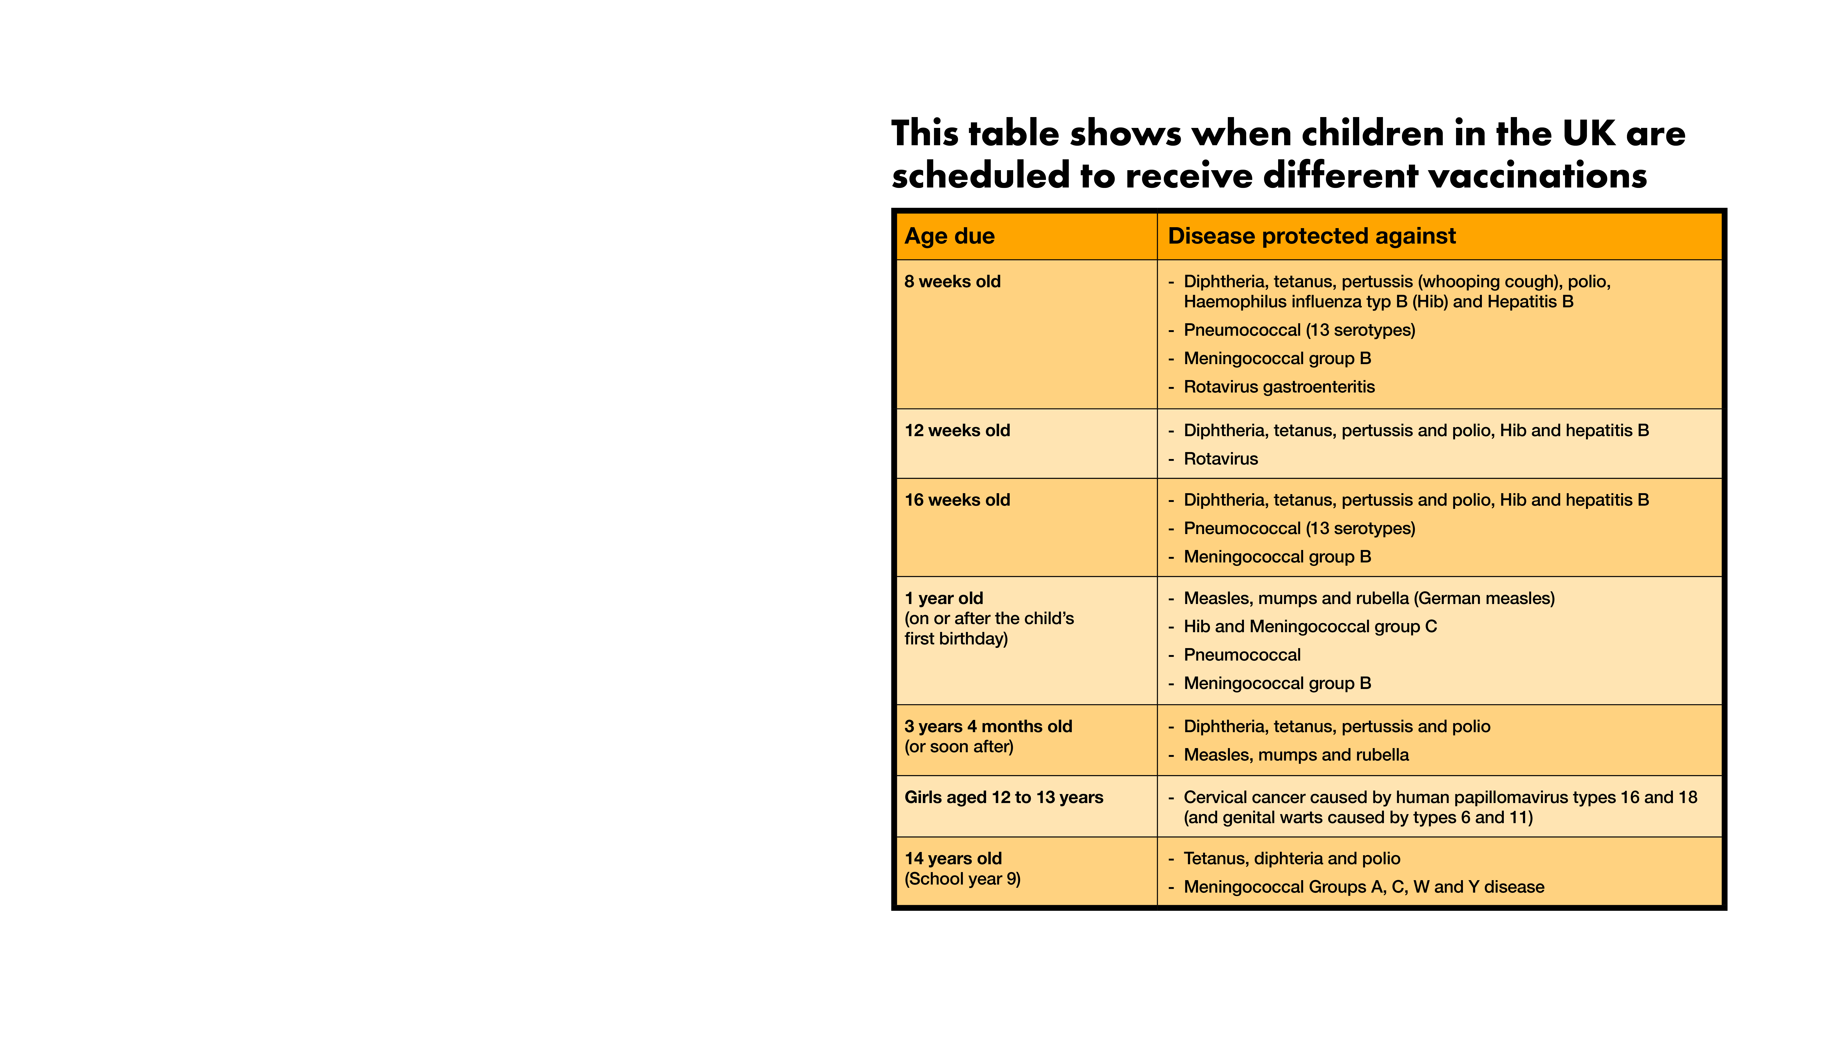
Do you know which vaccinations you’ve had?
Notes:
Teacher to discuss with pupils how many of these diseases they have heard of.

Slide 9
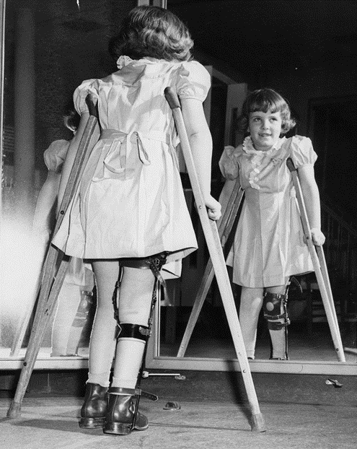
How do we eradicate a particular disease?
Polio is an infectious disease caused by a virus. It used to be very common around the world.
In some cases, the Polio virus attacked nerves in the spine and the base of the brain, which could lead to paralysis of the legs.
Notes:
Teacher to check that pupils understand the meaning of the word ‘eradicate’.
Eradicate: destroy or put an end to

Slide 10
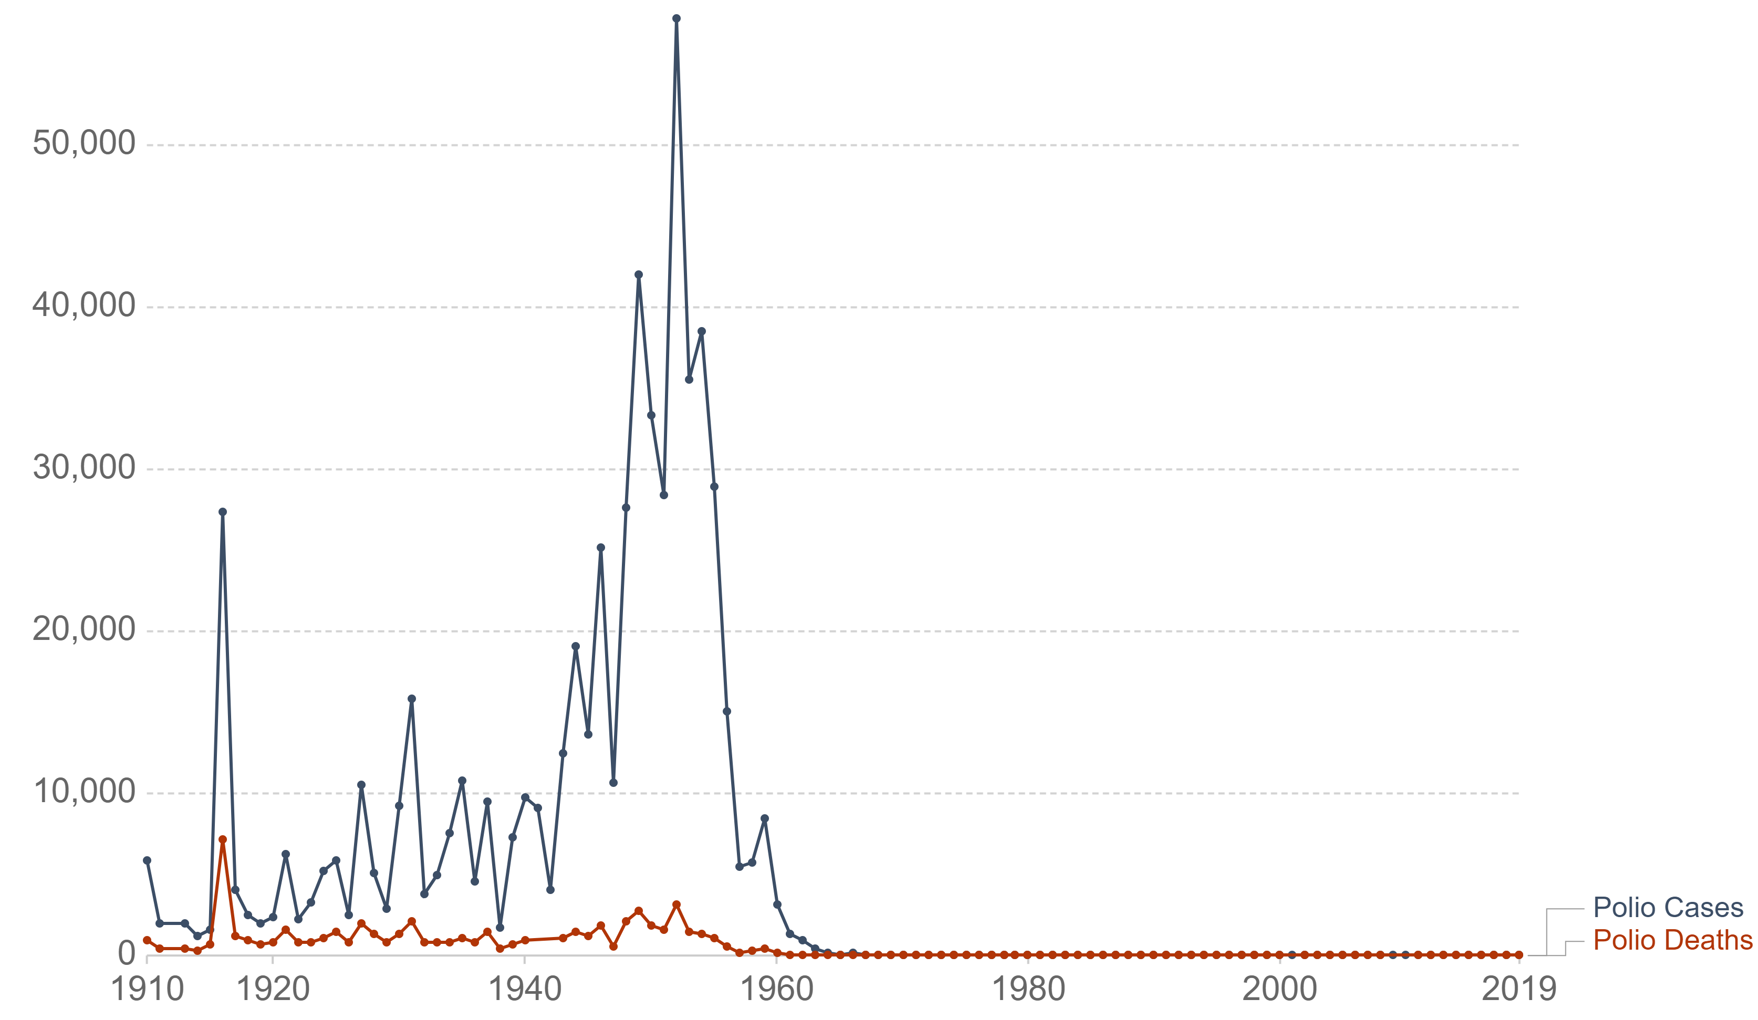
Polio vaccination programme in the USA
The graph below shows the number of polio cases and polio deaths in the USA since 1910.
What does the graph show?
A mass vaccination programme was introduced in the late 1950s and early 1960s in the USA.
The programme reduced the number of cases from 35,000 in 1953 to 161 in 1961. Since 1979, no cases of polio have originated in USA.
Number of people
Year
Notes:
Teacher to ask pupils what the graph shows. In particular, pupils can try to identify when there were polio outbreaks and when pupils think the vaccination programme was introduced in the USA. Also, teacher may ask pupils whether they think the vaccination programme was effective, and whether, in 2021, they think children in the USA still need to be vaccinated against polio.

Slide 11
Why is it important that everyone gets vaccinated?

Slide 12
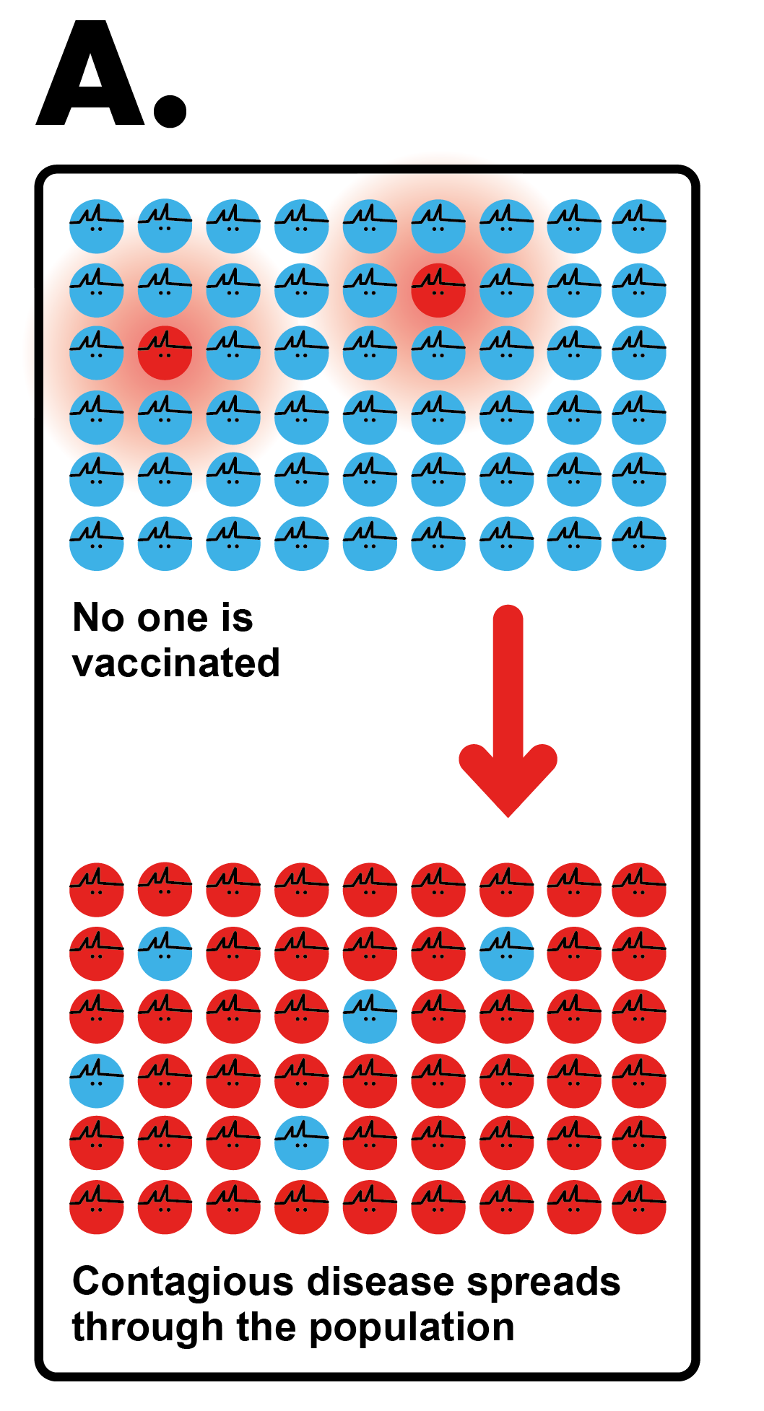
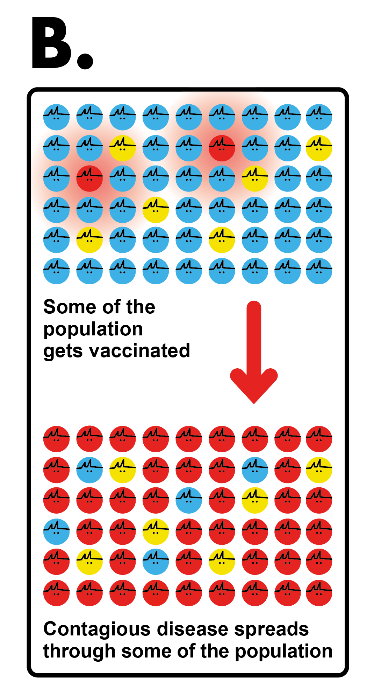
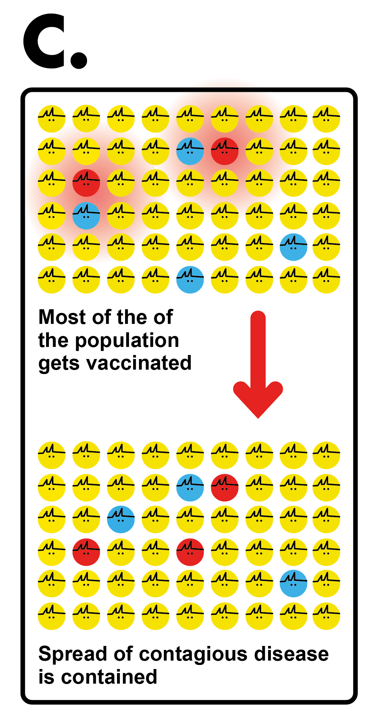
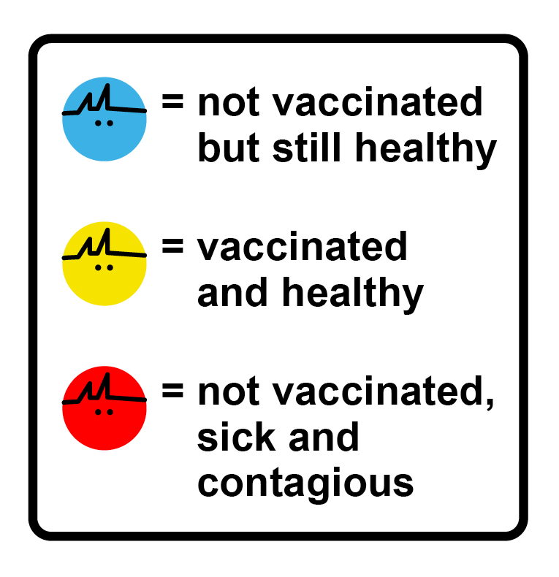
What do these diagrams show?
Notes:
This diagram shows what happens when no one is vaccinated.
This diagram shows what happens when some of the population is vaccinated.
This diagram shows what happens when most of the population is vaccinated. Herd immunity is achieved when most of the population is vaccinated against a particular disease.
Link back to the earlier question here if there were students who didn’t want to take the vaccine.

Slide 13
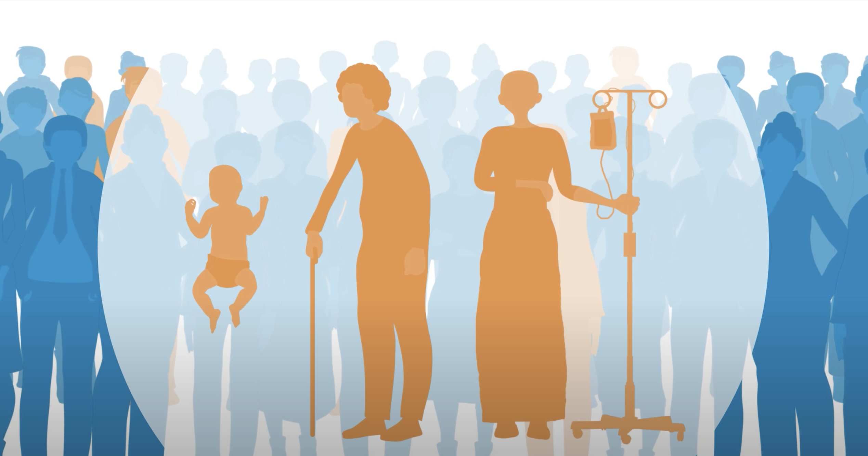
To contain or eradicate a disease through vaccinations, you need herd immunity.
This means that enough of the population are vaccinated against the disease that any spread of the disease is contained.
Measles is a serious disease caused by a virus. To achieve herd immunity with measles, you need at least 95% of the population vaccinated against it.
© Oxford VaccineGroup
Herd immunity
Notes:
The percentage of people who need to be immune in order to achieve herd immunity varies with each disease.
For example, herd immunity against measles requires about 95% of a population to be vaccinated.
The remaining 5% will be protected by the fact that measles will not spread among those who are vaccinated.
For polio, the threshold is about 80%.
The proportion of the population that must be vaccinated against COVID-19 to achieve herd immunity is not known.
One of the features of COVID-19 is that many people show no symptoms when infected. This makes it more difficult to eradicate as it is so hard to identify and isolate cases.
Taking the vaccine not only protects individuals against the disease but reduces the rate of transmission. However It should be noted that vaccinated individuals may still transmit the infection to those who haven’t been vaccinated.
Herd immunity does NOT mean everyone needs to have been infected with the disease. Contrary to popular opinion, most people have not been infected (the WHO estimate this figure as 90% of the population). Letting COVID-19 spread through populations, of any age or health status will lead to unnecessary infections, suffering and death.

Slide 14
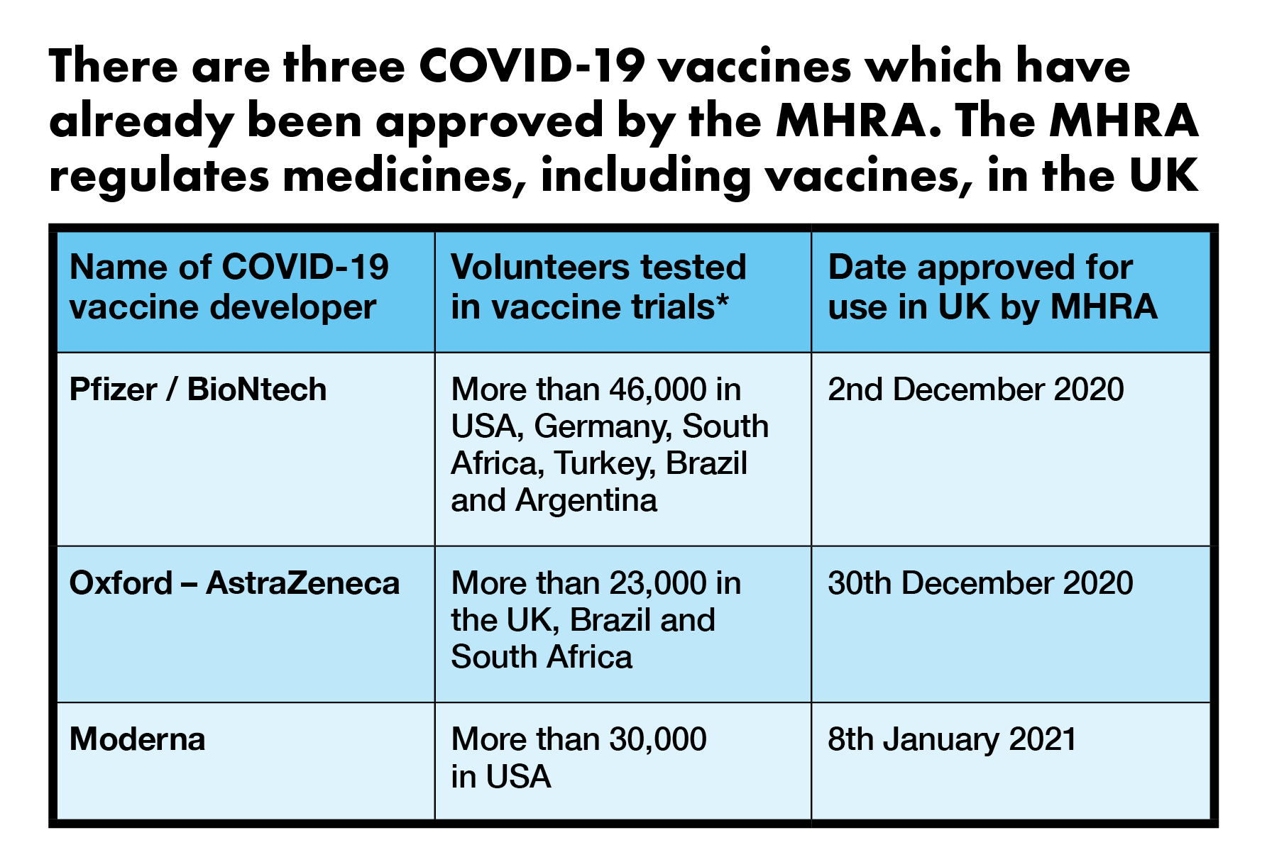
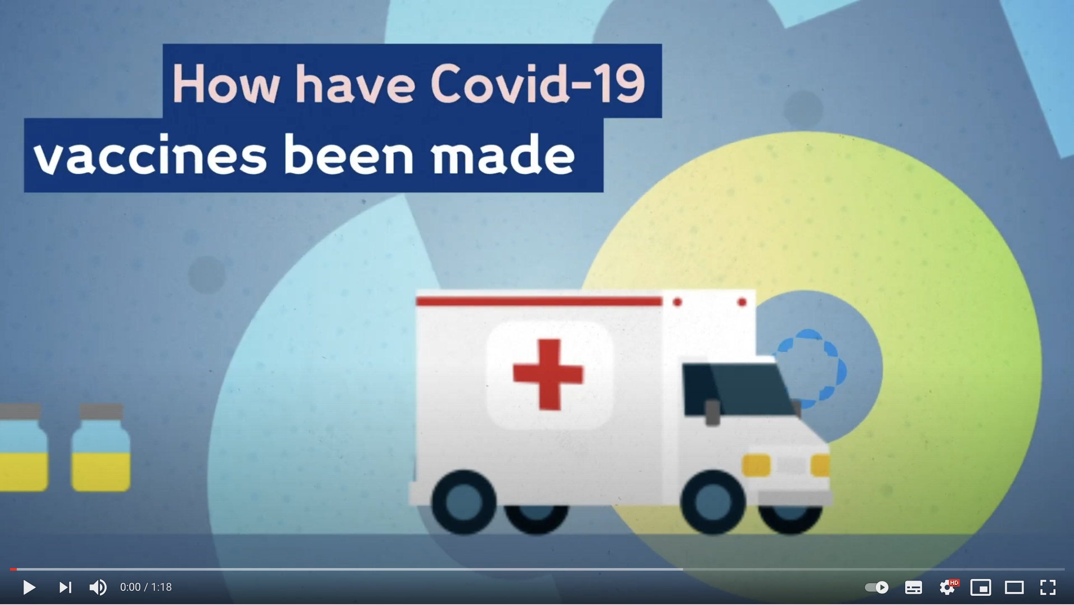
© Wellcome Trust
How have COVID-19 vaccines been made
*Volunteers taken from a range of ages and ethnicities
How have COVID-19 vaccines been made so quickly and yet safely?
Notes:
This is an important slide because some students may have concerns about the speed with which vaccines have been developed.
Key points to mention:
Vaccines are tested on many thousands of people in different parts of the world.
They include people of different ages and ethnicities.
They have been tested for both safety and effectiveness (efficacy).
Because vaccines work by triggering your immune system to produce a reaction, you can have side effects after you receive the vaccine that feel similar to having a real infection. Things like having a fever, or feeling achy, or getting a headache are common after receiving many vaccines and this is the same for the approved COVID-19 vaccines. Having these symptoms means that your immune system is working as it should be. Usually, these symptoms last a much shorter time than a real infection would (most are gone within the first 1–2 days).
You cannot get COVID-19 from any of the vaccines.
The following links gives information about each of the vaccine trials:
General overview of vaccine development: https://wellcome.org/news/quick-safe-covid-vaccine-development
Pfizer vaccine trial overview: https://www.pfizer.com/science/coronavirus/vaccine
Oxford vaccine trial overview: https://theconversation.com/oxford-scientists-how-we-developed-our-covid-19-vaccine-in-record-time-153135
Moderna vaccine trial overview: https://www.nih.gov/news-events/news-releases/promising-interim-results-clinical-trial-nih-moderna-covid-19-vaccine

Slide 15
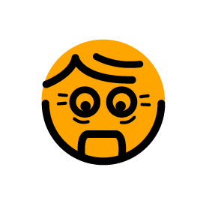
What will your next step be after this lesson?
All of these people have concerns about being vaccinated against COVID-19.
Discuss how you would explain to them the importance of having the vaccine.
I will wait a few years before I decide. I’m not scared of coronavirus anyway.
C.
The vaccine has things in it that I disagree with.
B.
The vaccine
hasn’t been
tested properly.
I’m worried about the side effects.
The vaccine
might give
me COVID.
A.
D.
Notes:
A suggested activity is for students to write a response to one or more of the characters on the slide. This could be a relative who has concerns about the vaccine. This activity is intended to review learning from the lesson.
Some example responses are given below:
Character A: None of the vaccines can give you COVID-19. They contain parts of the virus that stimulate your body to produce antibodies. Some people will feel side effects after taking the vaccine, but these are normal. They show that your immune system is working properly.
Character B: It is important that everyone who can take the vaccine gets it as soon as possible. This is to achieve herd immunity which will protect ourselves and our communities. Herd immunity is the only way we can stop the virus being transmitted. A useful overview video can be seen here: https://www.youtube.com/watch?v=8BUCi5Tuzms&feature=emb_logo (2:46)
Character C: None of the vaccines contain pork, alcohol or microchips. They contain parts of the virus that will stimulate the immune system. This will prevent someone from getting ill in future. These vaccines have been developed in the same way as other vaccines, which have been used safely and effectively for many years.
Character D: All the vaccines have been tested thoroughly for safety and effectiveness. They are safe and they work. Each of them has been tested on more than 20,000 people in a number of different countries, from a range of ages and ethnicities. The trial results have been closely studied and the vaccines have been approved by different international bodies. Any side effects mean that the immune system is working properly. However uncomfortable these are, the disease itself can be much worse.

Slide 16
Acknowledgements and sources
Sources
http://www.who.int/publications/10-year-review/vaccines/en/
Polio photo – Courtesy of Boston Children’s Hospital Archive: https://www.npr.org/sections/health-shots/2012/10/16/162670836/ wiping-out-polio-how-the-u-s-snuffed-out-a-killer?t=1611088331342
Polio graph: https://ourworldindata.org/polio
Information relating to vaccine trials https://www.pfizer.com/science/coronavirus/vaccine
https://theconversation.com/oxford-scientists-how-we-developed- our-covid-19-vaccine-in-record-time-153135
https://www.nih.gov/news-events/news-releases/promising-interim- results-clinical-trial-nih-moderna-covid-19-vaccine
Acknowledgements
These teaching resources were created by Hackney teachers and education specialists, for London schools, with help from the students of Stoke Newington School, as part of the Keep London Safe campaign.

